Slide 1
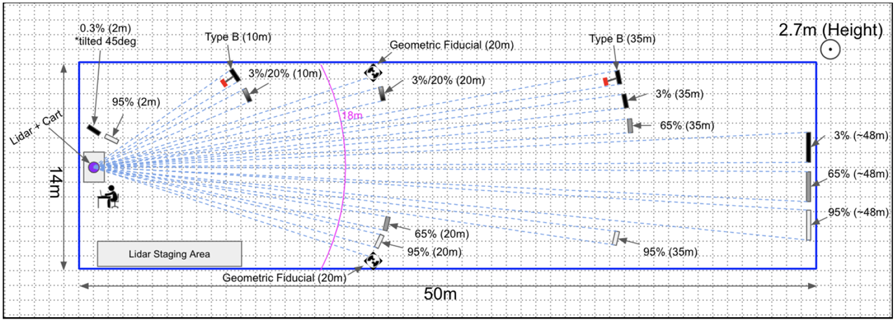
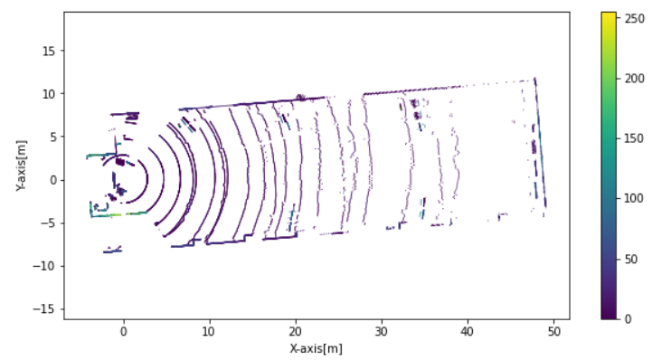
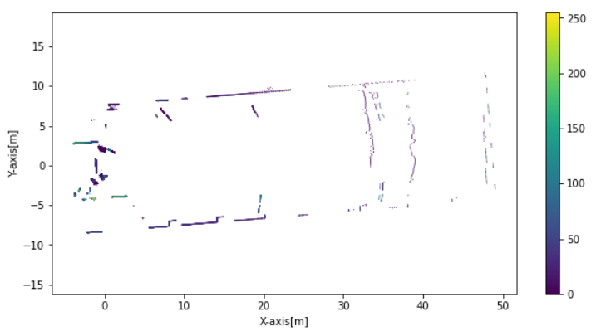
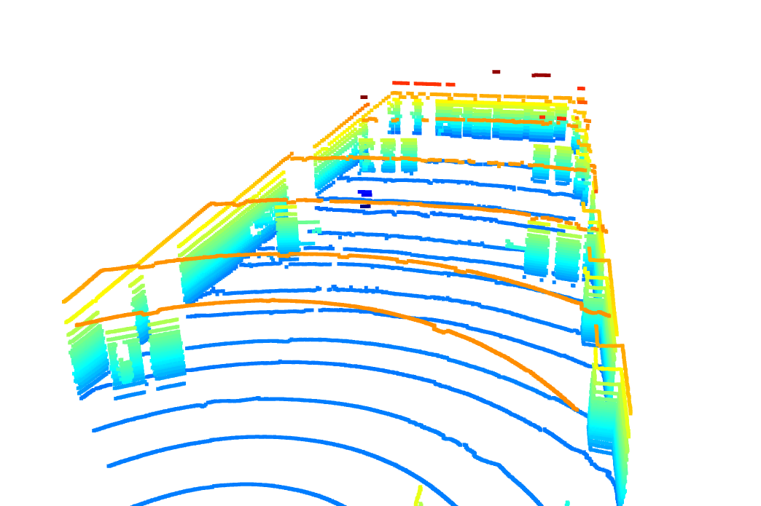
Velodyne VLP-32 M-LiDAR I 실내평가 CAL_ROOM
[raw data]
[바닥 pts 제거]
1-1
계산 방식
바닥 Point Cloud 제거(RANSAC)
Plane Segmentation
Target CLASS 분류
각 Target별 Accuracy, Precision 계산
Target | Range_GT [m] | Reflectivity | acc [cm] | RMSE [cm] | pts
1-1 | 10 | Type B | 8.66 | 2.71 | 267
1-2 | 10 | 3%/20% | 5.24 | 2.38 | 334
2-1 | 20 | 3%/20% | 8.53 | 3.28 | 135
2-2 | 20 | 95% | 6.99 | 8.36 | 37
2-3 | 20 | 65% | 9.53 | 6.4 | 112
3-1 | 35 | 3% | 5.12 | 2.52 | 78
3-2 | 35 | 65% | 3.46 | 1.53 | 72
3-3 | 35 | 95% | 0.24 | 1.65 | 33
4-1 | 48 | 3% | 1.14 | 14.41 | 34
4-2 | 48 | 65% | 6.56 | 6.08 | 70
4-3 | 48 | 95% | 8.74 | 7.34 | 73

Slide 2
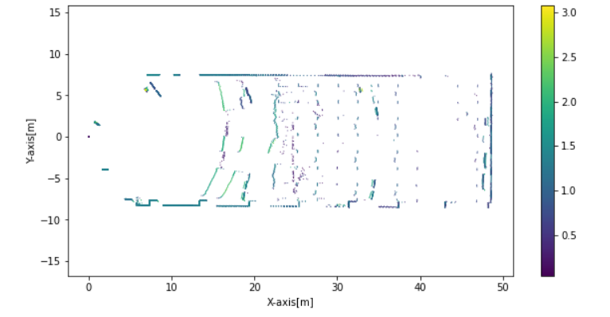
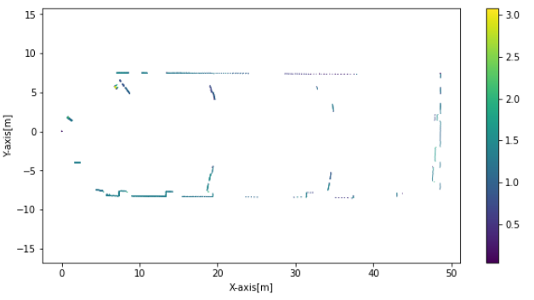
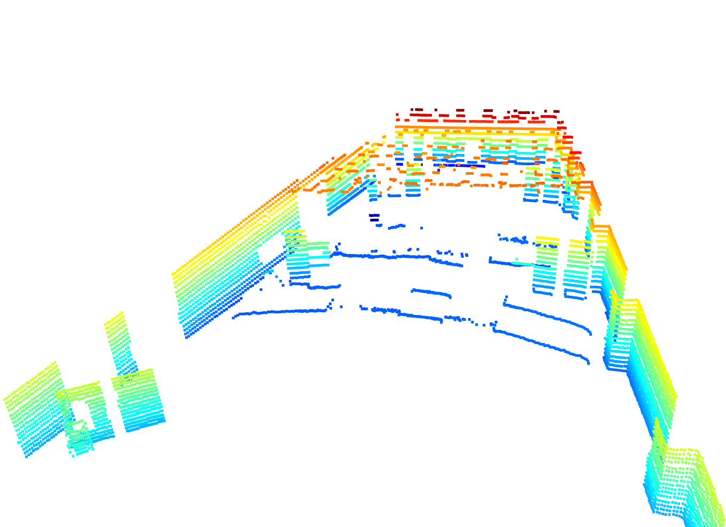
Valeo SCALA 2 I 실내평가 CAL_ROOM
[raw data]
[바닥 pts 제거]
1-1
계산 방식
바닥 Point Cloud 제거(RANSAC)
Plane Segmentation
Target CLASS 분류
각 Target별 Accuracy, Precision(RMSE) 계산
Target | Range_GT [m] | Reflectivity | acc [cm] | RMSE [cm] | pts
1-1 | 10 | Type B | 2.18 | 1.07 | 189
1-2 | 10 | 3%/20% | 4.41 | 1.26 | 198
2-1 | 20 | 3%/20% | 3.17 | 2 | 155
2-2 | 20 | 95% | 3.66 | 2.48 | 158
2-3 | 20 | 65% | 17.35 | 3.2 | 160
3-1 | 35 | 3% | 3.04 | 2.15 | 78
3-2 | 35 | 65% | 5.99 | 1.11 | 77
3-3 | 35 | 95% | 8.85 | 1.46 | 76
4-1 | 48 | 3% | 14.64 | 11.63 | 64
4-2 | 48 | 65% | 3.25 | 3.42 | 76
4-3 | 48 | 95% | 2.77 | 5.99 | 80

Slide 3
SONY POC I 실내평가 CAL_ROOM

